Slide 1
Real-Time System: Introduction

Slide 2
Introduction: Real-Time System
Real-time
Does not denote speed/fast
But meet the timing constraints or deadlines
Goal: make the system predictable and robust
Predictability: have deterministic behavior
Usually use the worst-case analysis
Guaranteed response/reaction times
Robustness: the job with granted performance will not be interfered with other job
Notes:
Real-time systems denotes to meet the timing constraints of tasks.
Why we introduce the real-time system: 1. predictability 2. robustness

Slide 3
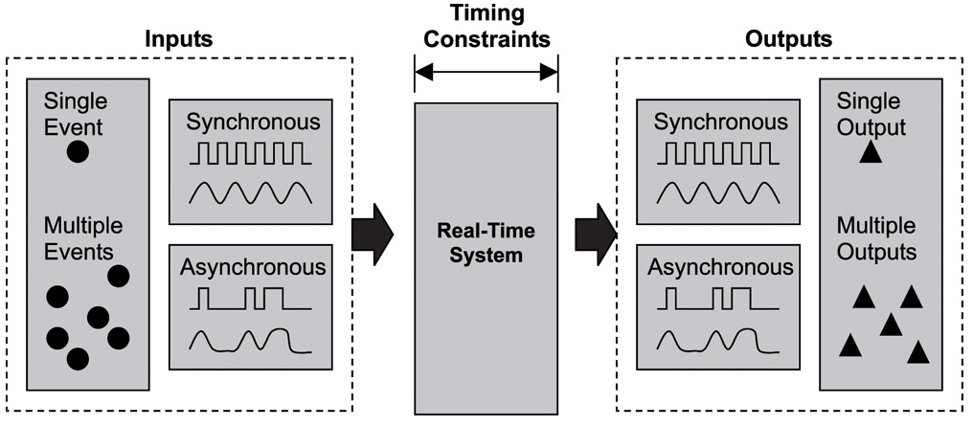
Introduction: Real-Time System
Real-time system: respond to external events in a timely fashion and the response time is guaranteed

Slide 4
Introduction: Real-Time System
Responding to external events includes
Recognize when an event occurs
Perform the required processing
Output the result within a given time constraint
Timing constraints include
Finish time
Both start time and finish time

Slide 5
Real-Time Systems
The structure of a real-time system is a controlling system and at least one controlled system
Controlling
System
input
output
Controlled
System
Controlled
System
Controlled
System
output
input

Slide 6
Real-Time Systems (Cont.)
The controlling system interacts with the controlled system in various ways
The interaction can be periodic
The controlling system -> the controlled system
Predictable and occurs at predefined intervals
The interaction can be aperiodic
The controlled system -> the controlling system
Unpredictable from random occurrences of external events
The communication can be a combination of both types
The controlling system must process and respond to the events and information generated by the controlled system in a guaranteed time frame.

Slide 7
Real-Time Systems Examples
Real-time weapons defense system
Controlling system
A command-and-decision (C&D) system
Controlled system
A radar system
Weapons firing control system
Communication between the radar system and C&D system is aperiodic
Communication between the C&D system and the weapon firing control system is periodic

Slide 8
Real-Time Systems Examples (Cont.)
Cruise missile guidance system
Controlling system
Navigation system: contain digital maps covering the missile flight path
Controlled system
Radar system
Divert-and-altitude-control system
Communication between radars and the navigation system is aperidoic
Communication between the navigation system and the diver-and-altitude-control system is periodic

Slide 9
Real-Time Systems Examples (Cont.)
DVD player
Controlling system
DVD player must decode both the video and audio streams from the disc simultaneously.
Controlled system
Remote control is viewed as a sensor to feed pause and language selection events into DVD player

Slide 10
Characteristics of Real-Time Systems
Characteristics
Must produce correct computational results, called logical or functional correctness
These computations must conclude within a predefined period, called timing correctness
The overall correctness of a real-time system depends on both the functional correctness and the timing correctness

Slide 11
Type of Real-Time System
Hard Real-Time
Soft Real-Time
Firm
Notes:
Real-time System can be classified as hard real-time system, soft real-time system and firm real-time system.

Slide 12
Hard Real-Time System
Degree of tolerance of missed deadline
Extremely small or zero
Usefulness of computed results after missed deadlines
Likely useless
Severity of the penalty incurred for failing to meet deadlines
catastrophe

Slide 13
Hard Real-Time System
Examples:
Nuclear reactors
Flight controller
Weapon defense system
Missile guidance system
Notes:
For hard-real-time system, missing tasks’ deadlines would cause catastrophic consequence. For example, nuclear reactors and flight controllers are all hard-real-time systems.

Slide 14

Hard Real-Time System

Slide 15
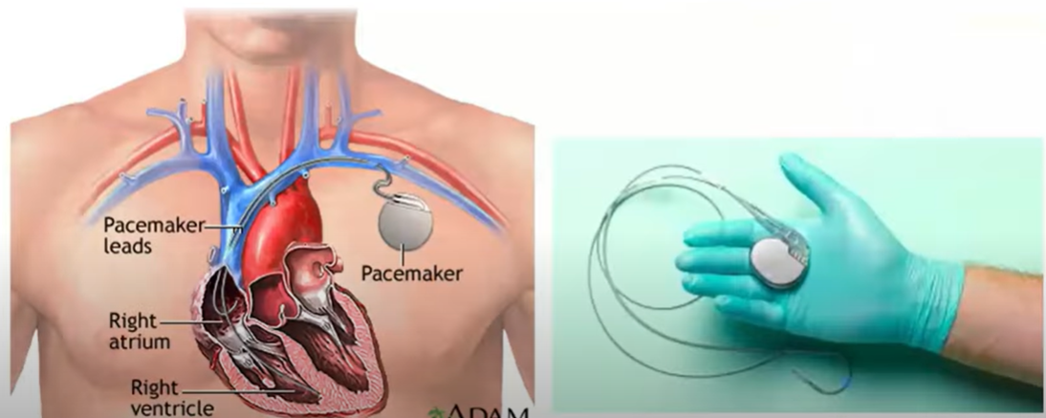
Hard Real-Time System

Slide 16
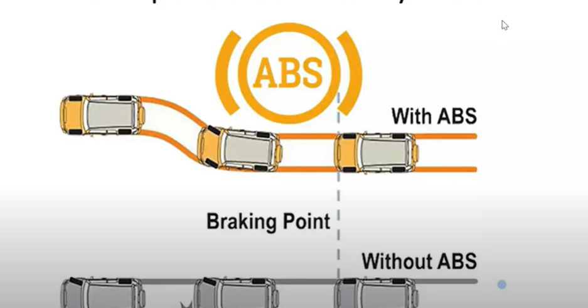
HArd Real-Time System

Slide 17

Hard Real-Time System

Slide 18
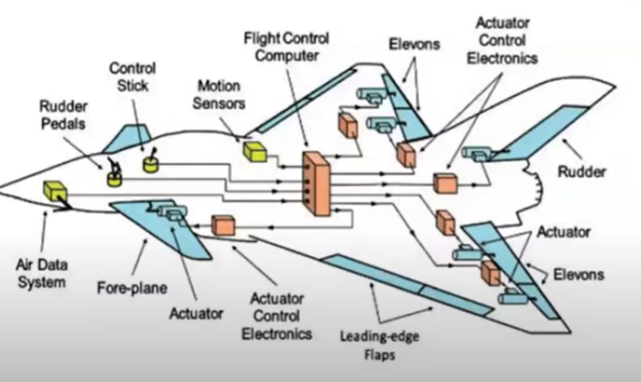

Slide 19
Soft Real-Time System
Degree of tolerance of missed deadline
Non-zero
Usefulness of computed results after missed deadlines
Have a rate of depreciation
Severity of the penalty incurred for failing to meet deadlines
Non-catastrophic

Slide 20
Soft Real-Time System
A miss of timing constraints is undesirable. However, a few misses do no serious harm
The timing requirements are often specified in probability terms
The time constraints are guaranteed on a statistical basis
Examples:
Multimedia Streaming
Electronic games
Quality-of-Service (QoS) guarantees
Notes:
Missing a task’s deadline in a soft real-time system will only decrease the performance of the system, but not influence system’s correct behavior. For example, multimedia streaming, electronic games, and quality-of-service applications are all soft-real-time systems.

Slide 21

Soft Real-Time System

Slide 22

Soft Real-Time System

Slide 23
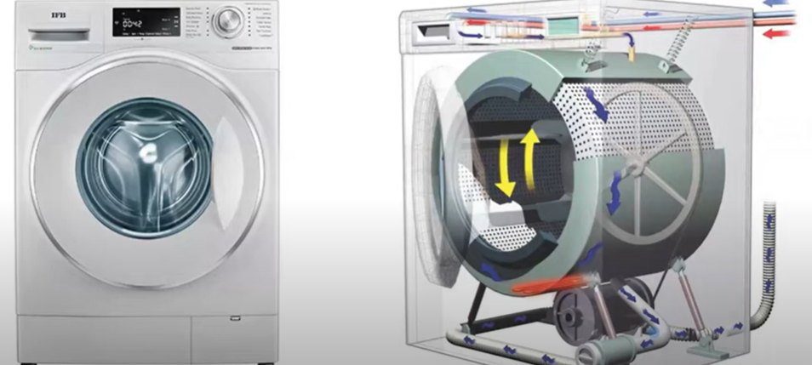
Soft Real-Time System

Slide 24
Comparison
Value
Deadline
Soft RTS
Hard RTS
Time
Notes:
This is the comparison of hard and soft real-time systems.
X-axis denotes the time while Y-axis denotes the value.
For hard RTS, once missing deadline, the system’s value is negative, which means the system is damaged. In contrast, in a soft RTS, the value is still positive after missing deadline. However, if the finish time is far behind deadline, the value would also become negative.

Slide 25
Job versus Task
Job: unit of work that is scheduled and executed by the system
Computation of a FFT (Fast Fourier Transform)
Transmission of a data packet
Task: a set of related jobs which jointly provide some system function
Notes:
We assume that system activation entities consists of Job and Task.
Job denotes a set of execution flow while Tasks denotes a set of related jobs that cooperate to provide a specific system function.

Slide 26
Release Time and Deadlines
Release time
the instant of time at which the job becomes available for execution
Jobs have no release time if all the jobs are released when the system begins execution
Response time
The length of time from the release time of the job to the instant when it completes
Notes:
This and following slides shows the job’s timing characteristics, including release time, response time, relative deadlines and (absolute deadline)

Slide 27
Release Time and Deadlines (Cont.)
Relative deadline
The maximum allowable response time of a job
Deadline or Absolute Deadline
The instant of time by which its execution is required to be completed
Equal to the release time plus the relative deadline
A job has no deadline if its deadline is at infinity

Slide 28
Feasibility
Timing Constraints
A constraints imposed on the timing behavior of a job
Specified in terms of
Release time
Relative deadline or absolute deadline
The set of rules that determines the order in which tasks are executed is called a scheduling algorithm
A schedule is feasible if all tasks can be completed according to the timing constraints
A set of tasks is schedulable if there exists at least one algorithm that can produce a feasible schedule

Slide 29
Type of Tasks
A Periodic task is executed repeatly at regular time intervals, and each invocation is called a job or instance.
Often time-driven
A Aperiodic task is executed to response to external events, and to respond, it executes aperiodic jobs whose release time are not know a priori
Often event-driven
Off-line guarantee of aperiodic tasks must make proper assumptions on the environments; that is, by assuming a maximum arrival rate for each event (i.e., minimum interarrival time)
Aperiodic tasks characterized by a minimum interarrival time are called sporadic tasks
Notes:
According to the regularity of task’s activation, we divide the tasks into two sets: on is the periodic task and the other is the aperiodic task.
Periodic tasks are regularly activated at a constant rate. Each invocation activity is called a job or an instance.
In contrast, the invocation of aperiodic tasks are not regular and undetermined. Thus, it is often event-driven.
Notably, since the uncertainly of tasks’ invocations, to off-line guarantee of aperiodic tasks’ execution, we may assume a maximum arrival rate for each event. A aperiodic task that is characterized by a minimum interval time is called a sporadic task.

Slide 30
Classification of Scheduling Algorithm
Preemptive/Nonpreemptive
Preemptive: the running tasks can be interrupted to assign the processor to another task
Non-preemptive: A task, once started, is executed until completion.
Static/Dynamic
Static: the scheduling decisions are based on fixed parameters and assigned to tasks before their activation
Dynamic: the scheduling decisions are based on dynamic parameters that may change during system evolution
Notes:
The scheduling algorithms can be classified as
Preemptive or nonpreemptive
Static or dynamic
Off-line or on-line
Optimal or heuristic
Dynamic or fixed

Slide 31
Classification of Scheduling Algorithm (Cont.)
Off-line/On-line
Off-line: a scheduling algorithm is executed on the entire task set before actual task activation. The schedule may be stored in a table and later executed by a dispatcher
On-line: scheduling decisions are taken at runtime every time a new task enter the system or when a running task terminates

Slide 32
Classification of Scheduling Algorithm (Cont.)
Optimal/Heuristic
Optimal: an algorithm is optimal if it minimizes some given cost function defined over the task set.
If no cost function is given and only concern feasibility, an algorithm is optimal if it may fail to meet deadline only if no other algorithms can meet it
Heuristic: an algorithm is heuristic if it tends toward but does not guarantee to find the optimal schedule
Dynamic/Fixed
Fixed: in which the priority of each process is fixed for any instantiation
Dynamic: in contrast from above

Slide 33
Metrics for Performance Evaluation
Metrics for hard real-time system
Schedulability
Optimality, etc.
Metrics for soft real-time system
Miss ratio
Response time, etc.
Other metrics
Completion time
Jitter, etc.
Combination of metrics
Notes:
To evaluate a hard real-time system, the metrics may be schedulability, optimality etc.
In contrast, to evaluate a soft real-time system, the metrics may be miss ratio, response time, etc.
Other metrics, including the completion time, jitter, may also be applied in the evaluation of a hard or soft real-time system

Slide 34
Commonly Used Approaches to Real-Time Scheduling
Clock-Driven
Priority-Driven
Notes:
The approaches to implement a real-time scheduling algorithm, depending on its characteristics, may be clock-driven or priority-driven.

Slide 35
Clock-Driven Approach
Also called time-driven
Because each scheduling decision is make at a specific time, independent of events, such as job releases or completions, in the system
Applicable only when the system is deterministic, except for a few aperiodic jobs
The parameters of all periodic tasks are known a priori
Therefore, the scheduler is often constructed by a static schedule of the jobs off-line
Use a hardware timer to trigger the scheduling decision
Notes:
Clock-driven approach is also called time-driven. To adopt the clock-driven approach, the system must be deterministic. For example, the scheduling algorithm for periodic tasks may use the clock-driven approach since their parameters are know a priori. As a result, the scheduler often constructed by a static schedule off time.

Slide 36
Priority-Driven Approach
Scheduling decisions are made when events, such as release and completions of job occurs
Therefore, priority-driven algorithms are even-driven
Many non-real-time scheduling algorithms are priority-driven
FIFO (First-In-First-Out)
Assign priority according to the release time
SETF (Shortest-Execution-Time-First)
Assign priority on the basis of job execution times
Notes:
Priority-driven approach assigns each task a different priority and schedules tasks on the basis of their priority.
To assign a task’s priority, we may choose a task’s real-time or deadlines to determine its priority. Thus, priority-driven algorithms are event-driven and the event are tasks’ priority.
Some well-known priority-driven algorithms are FIFO and SETF.

Slide 37
Priority-Driven Approach (Cont.)
Priority-driven real-time scheduling algorithms
Dynamic-priority
e.g. EDF (Earliest Deadline First)
Fixed-priority
e.g. RM (Rate Monotonic)
Notes:
For real-time systems, depending on whether dynamic or fixed or not, the priority-driven approaches may be dynamic-priority or fixed-priority.
The well-known EDF algorithm is a dynamic-priority driven algorithm. In contrast the RM is a fixed-priority driven algorithm

Slide 38
Issues of Real time OS
Race condition
Dead lock
Live lock
Starraing/Aging

